Slide 1
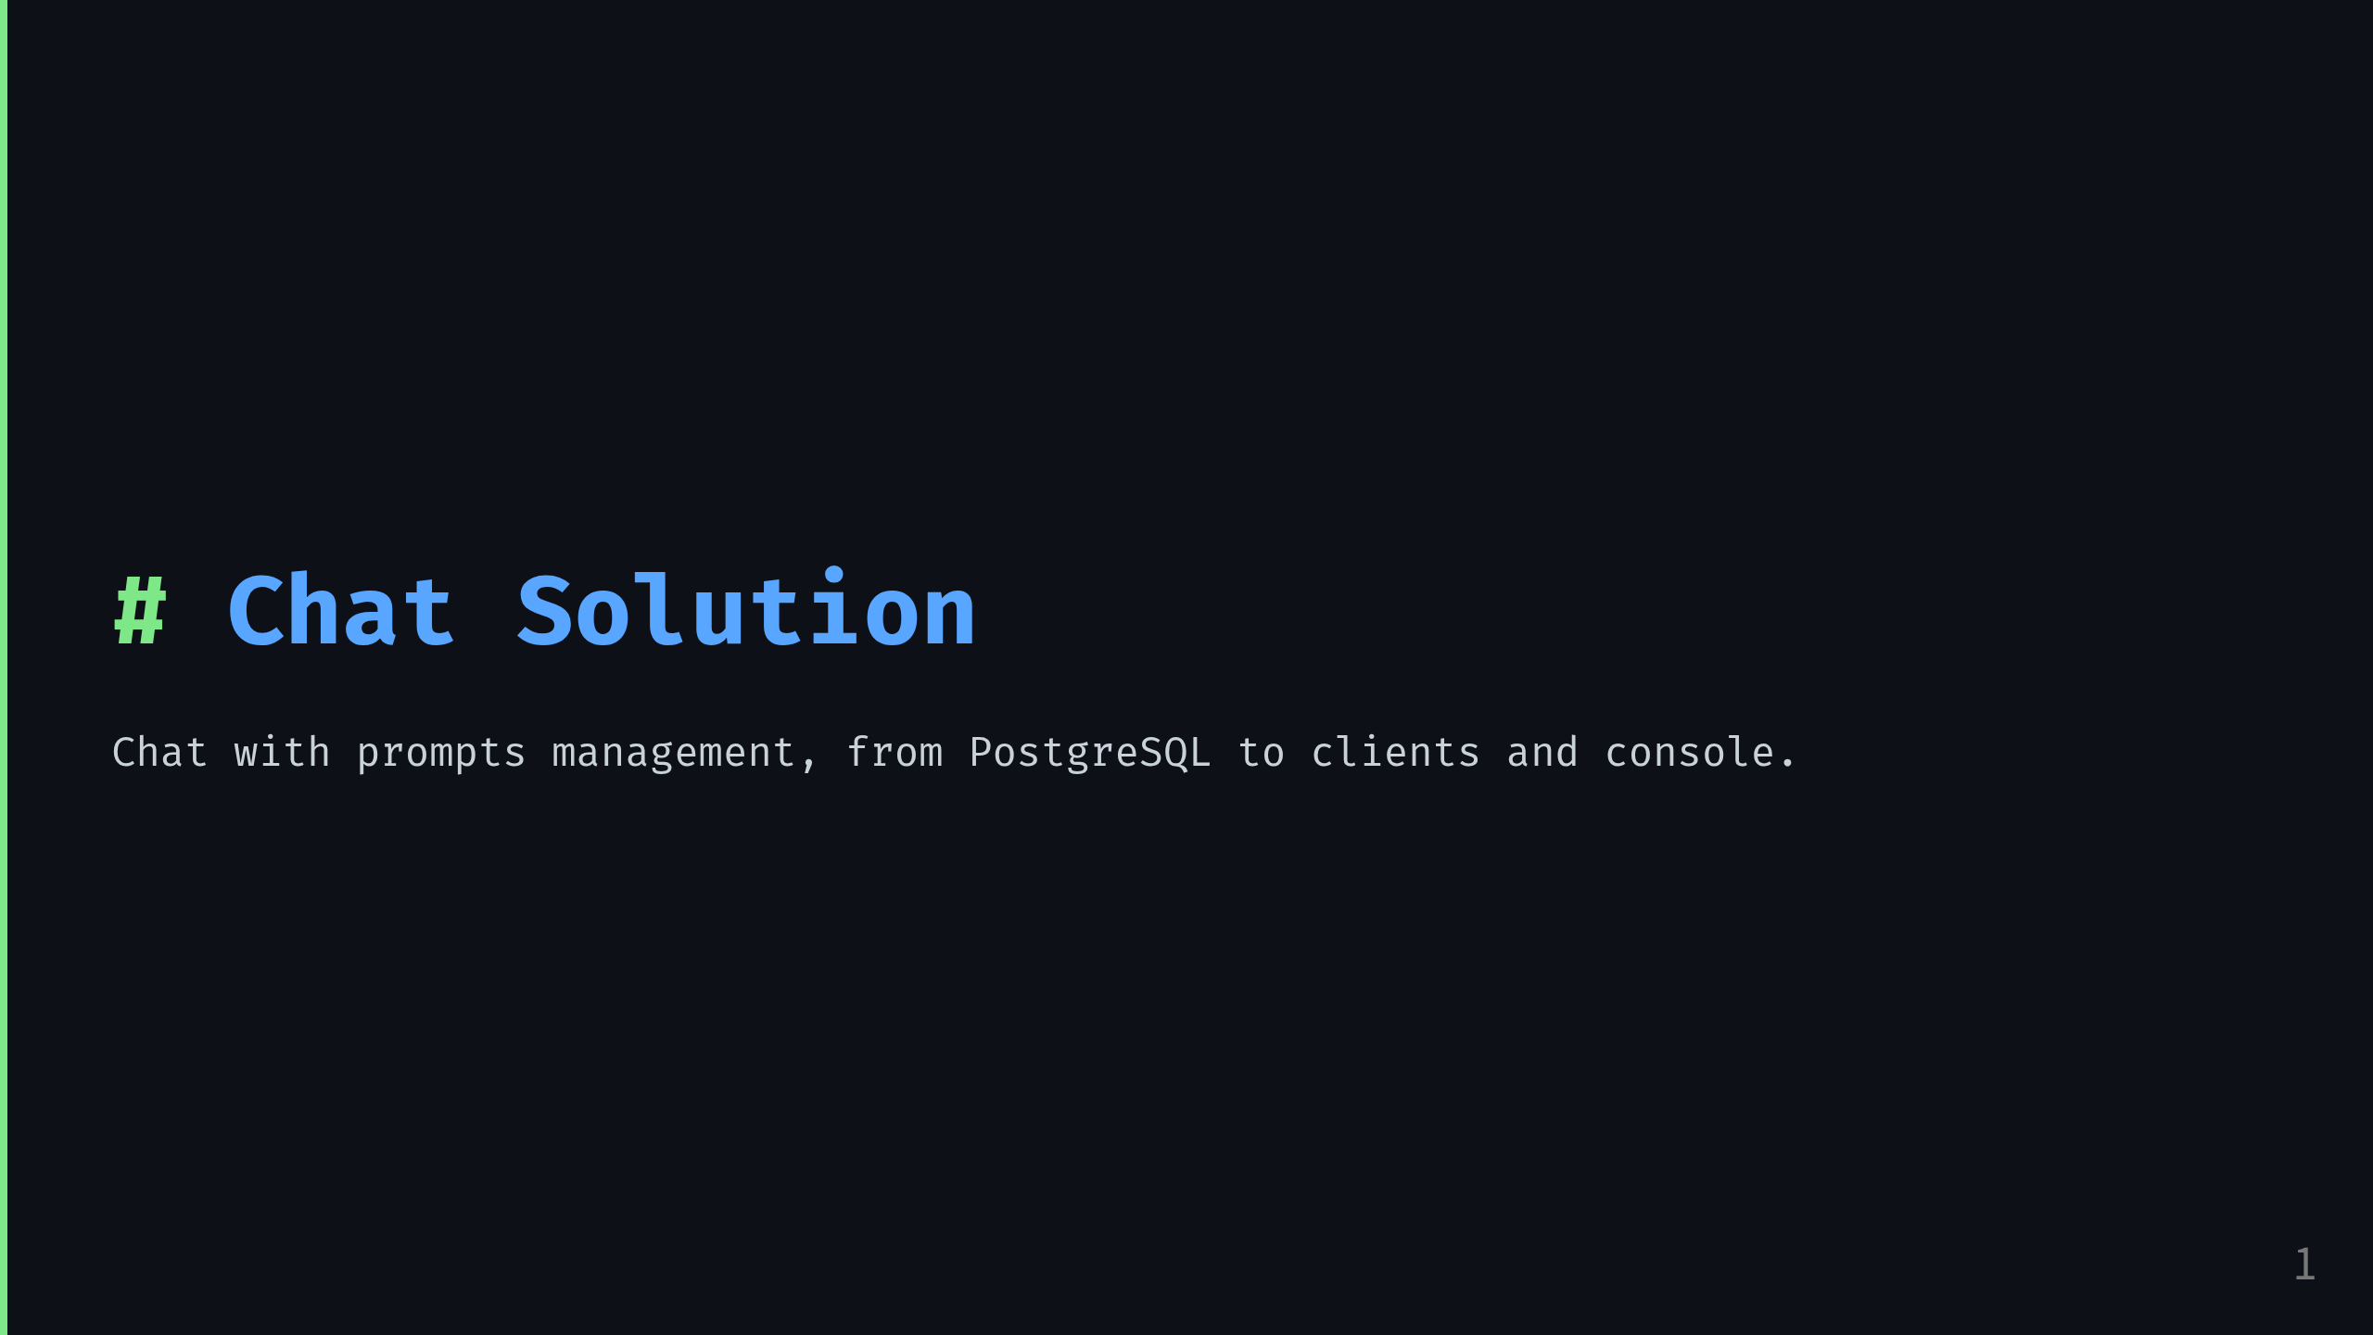
Notes:
Presenter note:
Start by framing the demo as a complete, reusable CRUD pattern:
tasks with reusable taxonomies, one contract, several clients, and a working console.

Slide 2
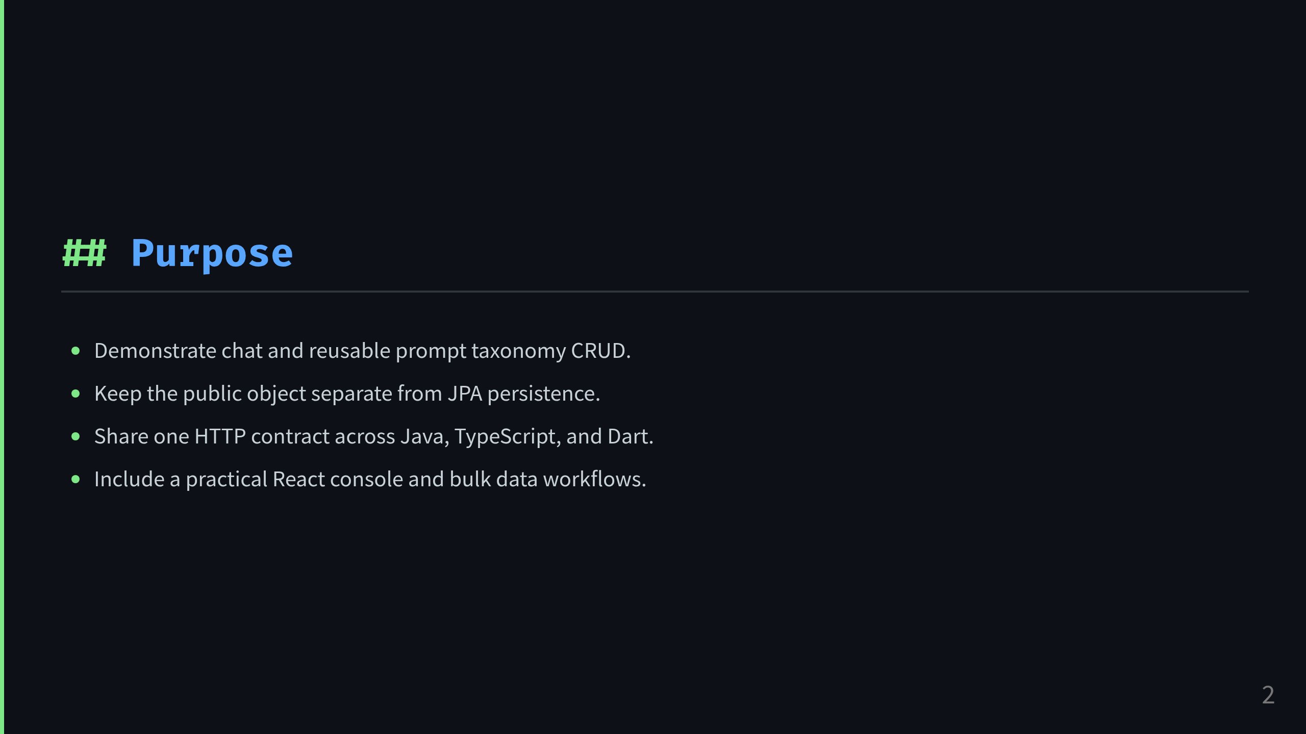
Notes:
Presenter note:
This is a reference implementation for a real CRUD feature:
small enough to explain, complete enough to show how the stack fits together.

Slide 3
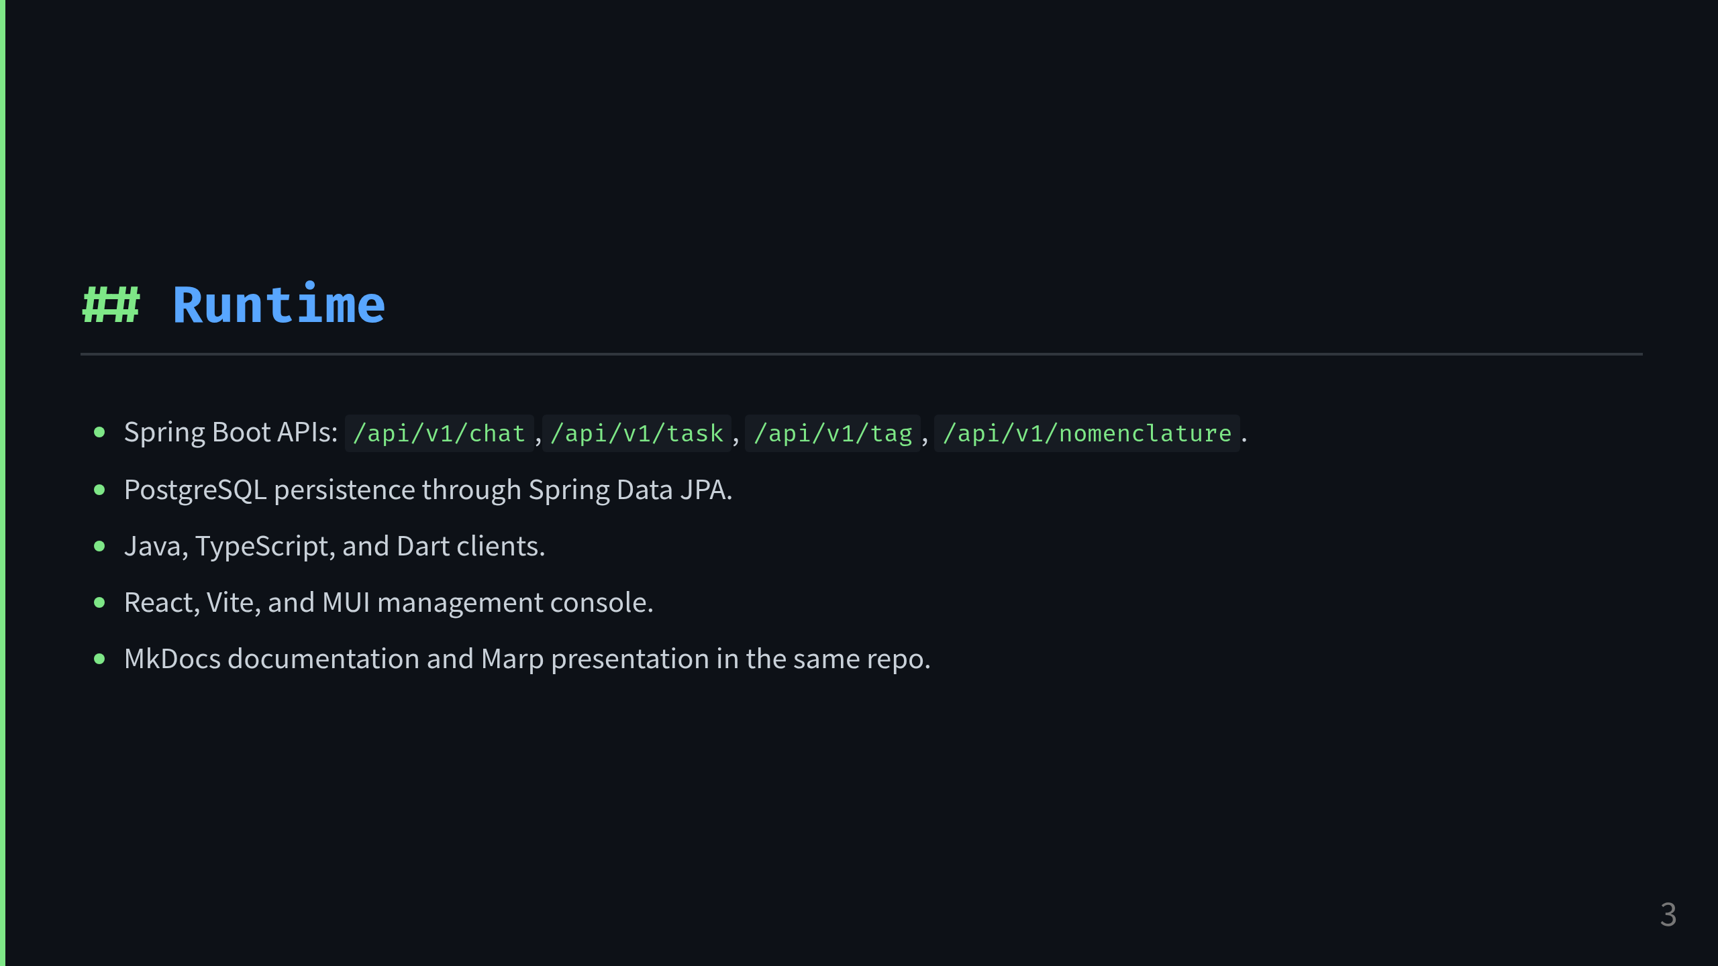
Notes:
Presenter note:
Walk through the runtime stack from API to database, then to clients and console.
Emphasize this is not just backend-only work.

Slide 4
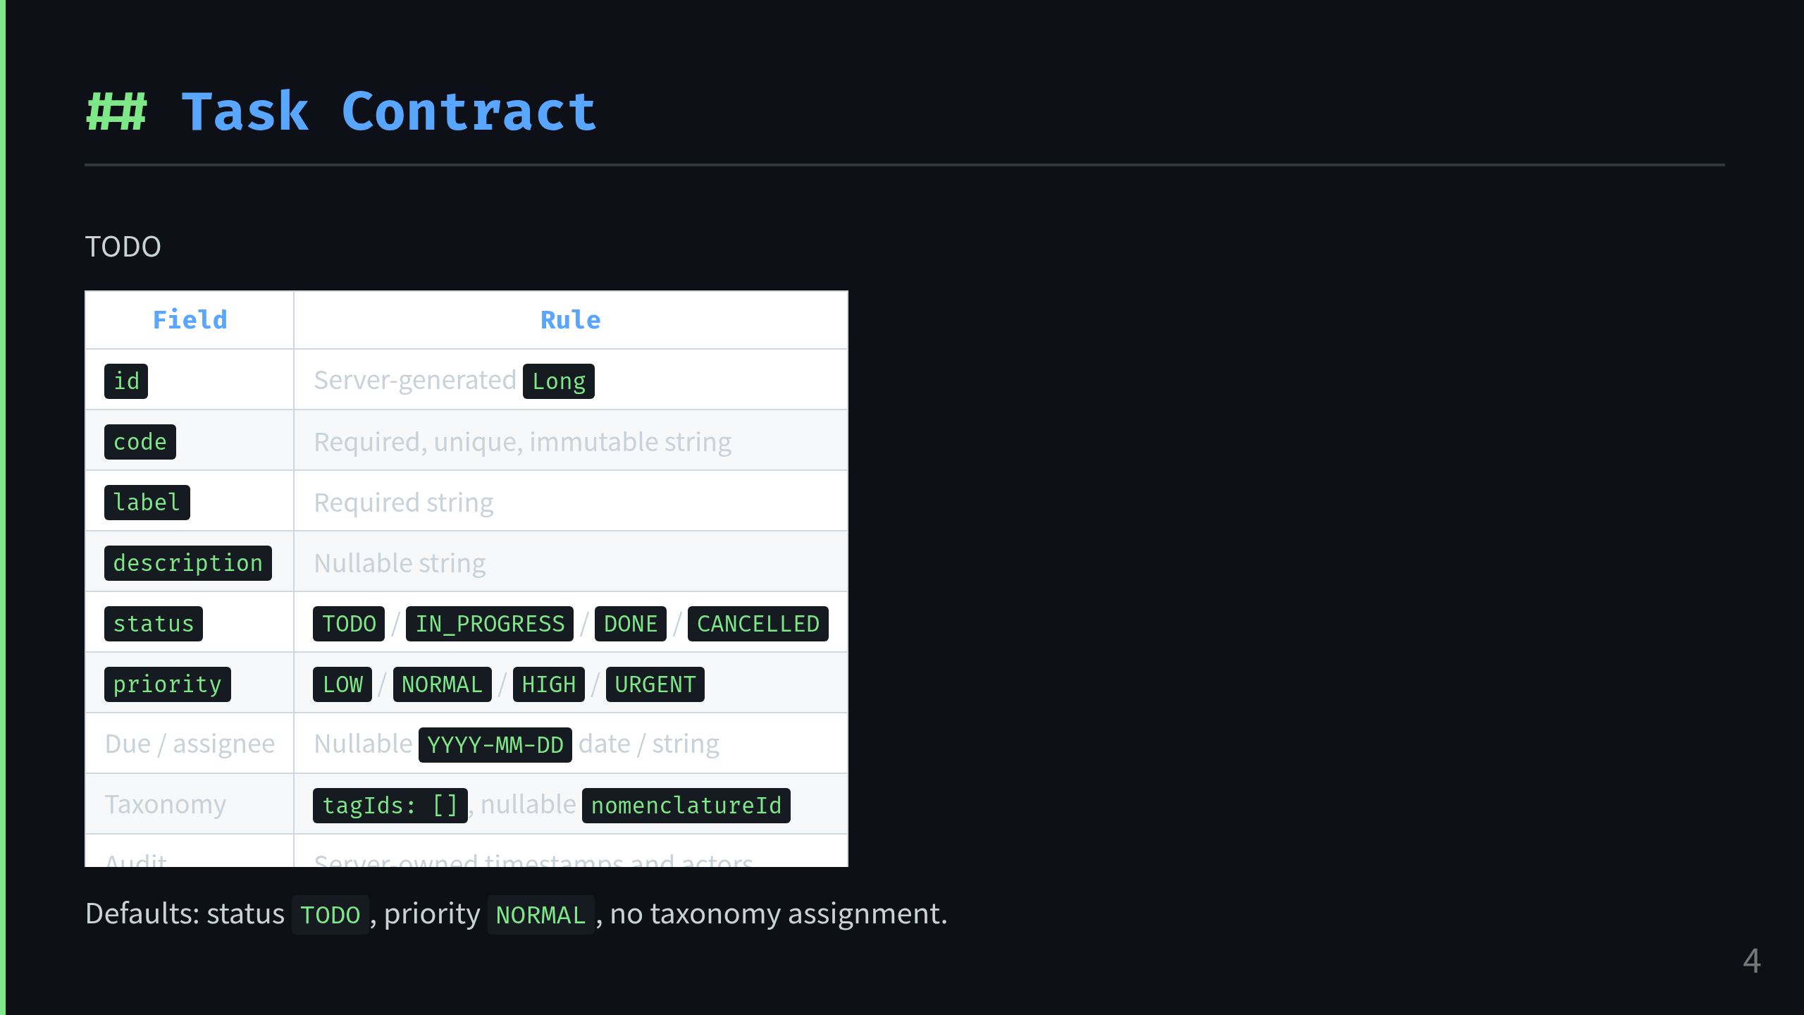
Notes:
Presenter note:
Explain the contract first.
The important design decision is that the public model is stable and intentionally different from the database entity.

Slide 5
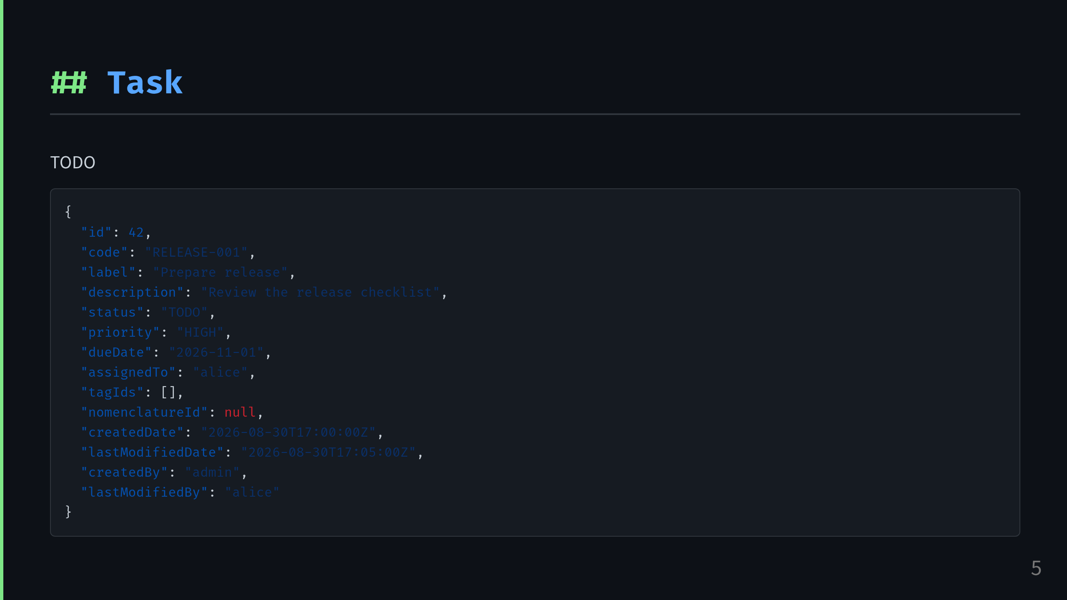
Notes:
Presenter note:
Use this example to show the actual JSON response and call out the immutable code value and timestamp semantics.

Slide 6
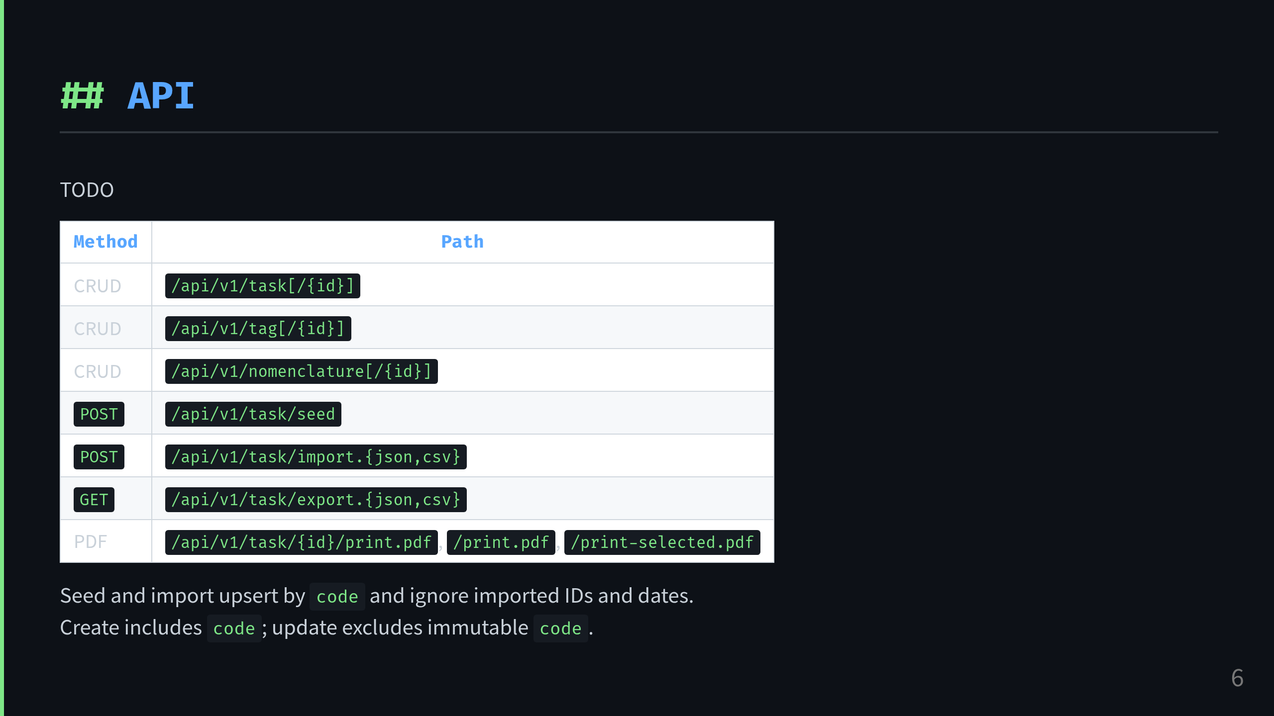
Notes:
Presenter note:
This is the main API surface.
Highlight that seed and import are operational shortcuts, while the CRUD endpoints expose the standard model lifecycle.

Slide 7
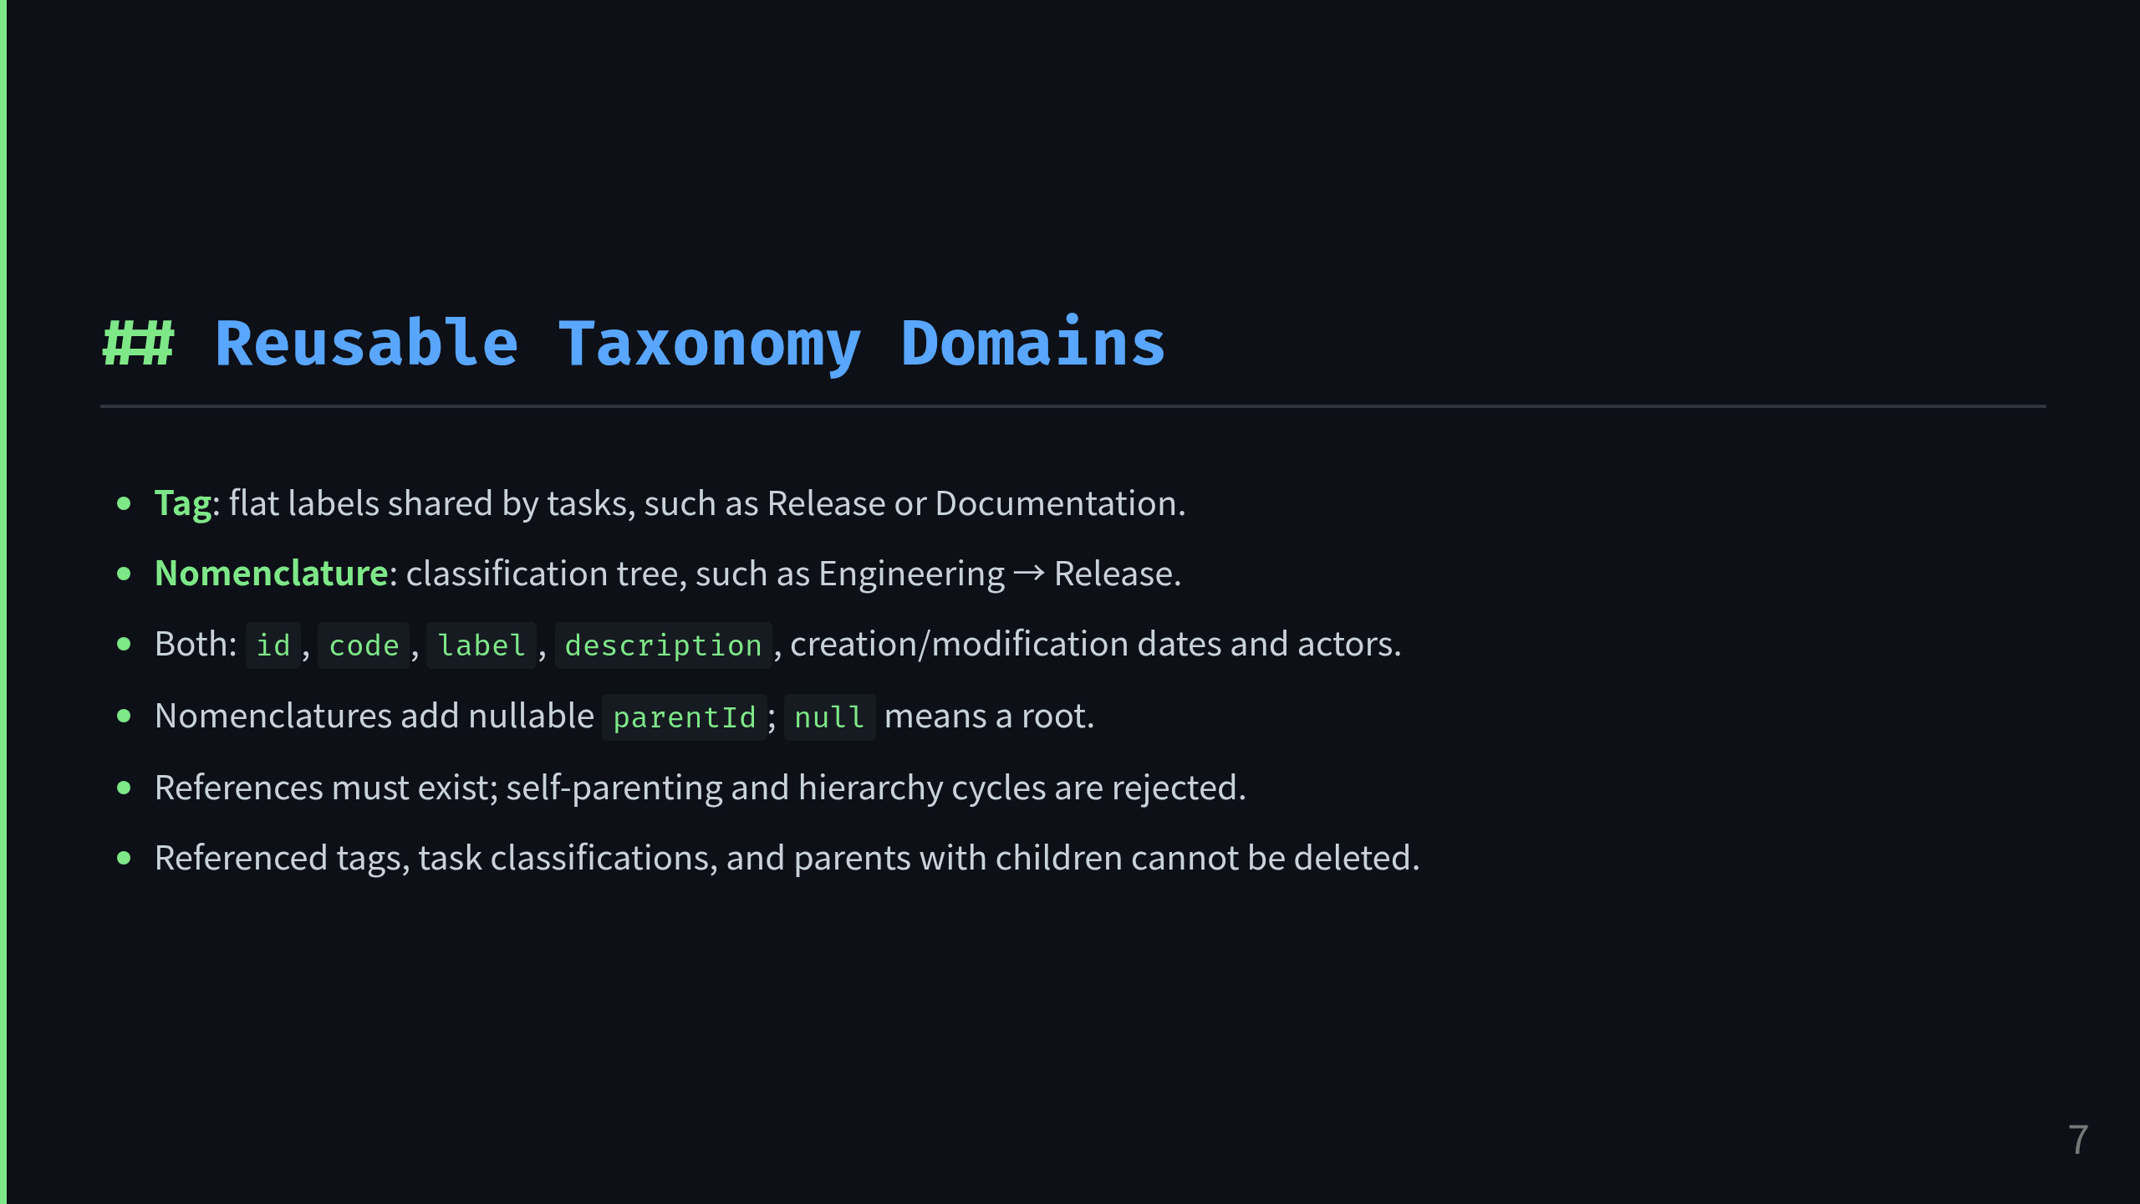

Slide 8
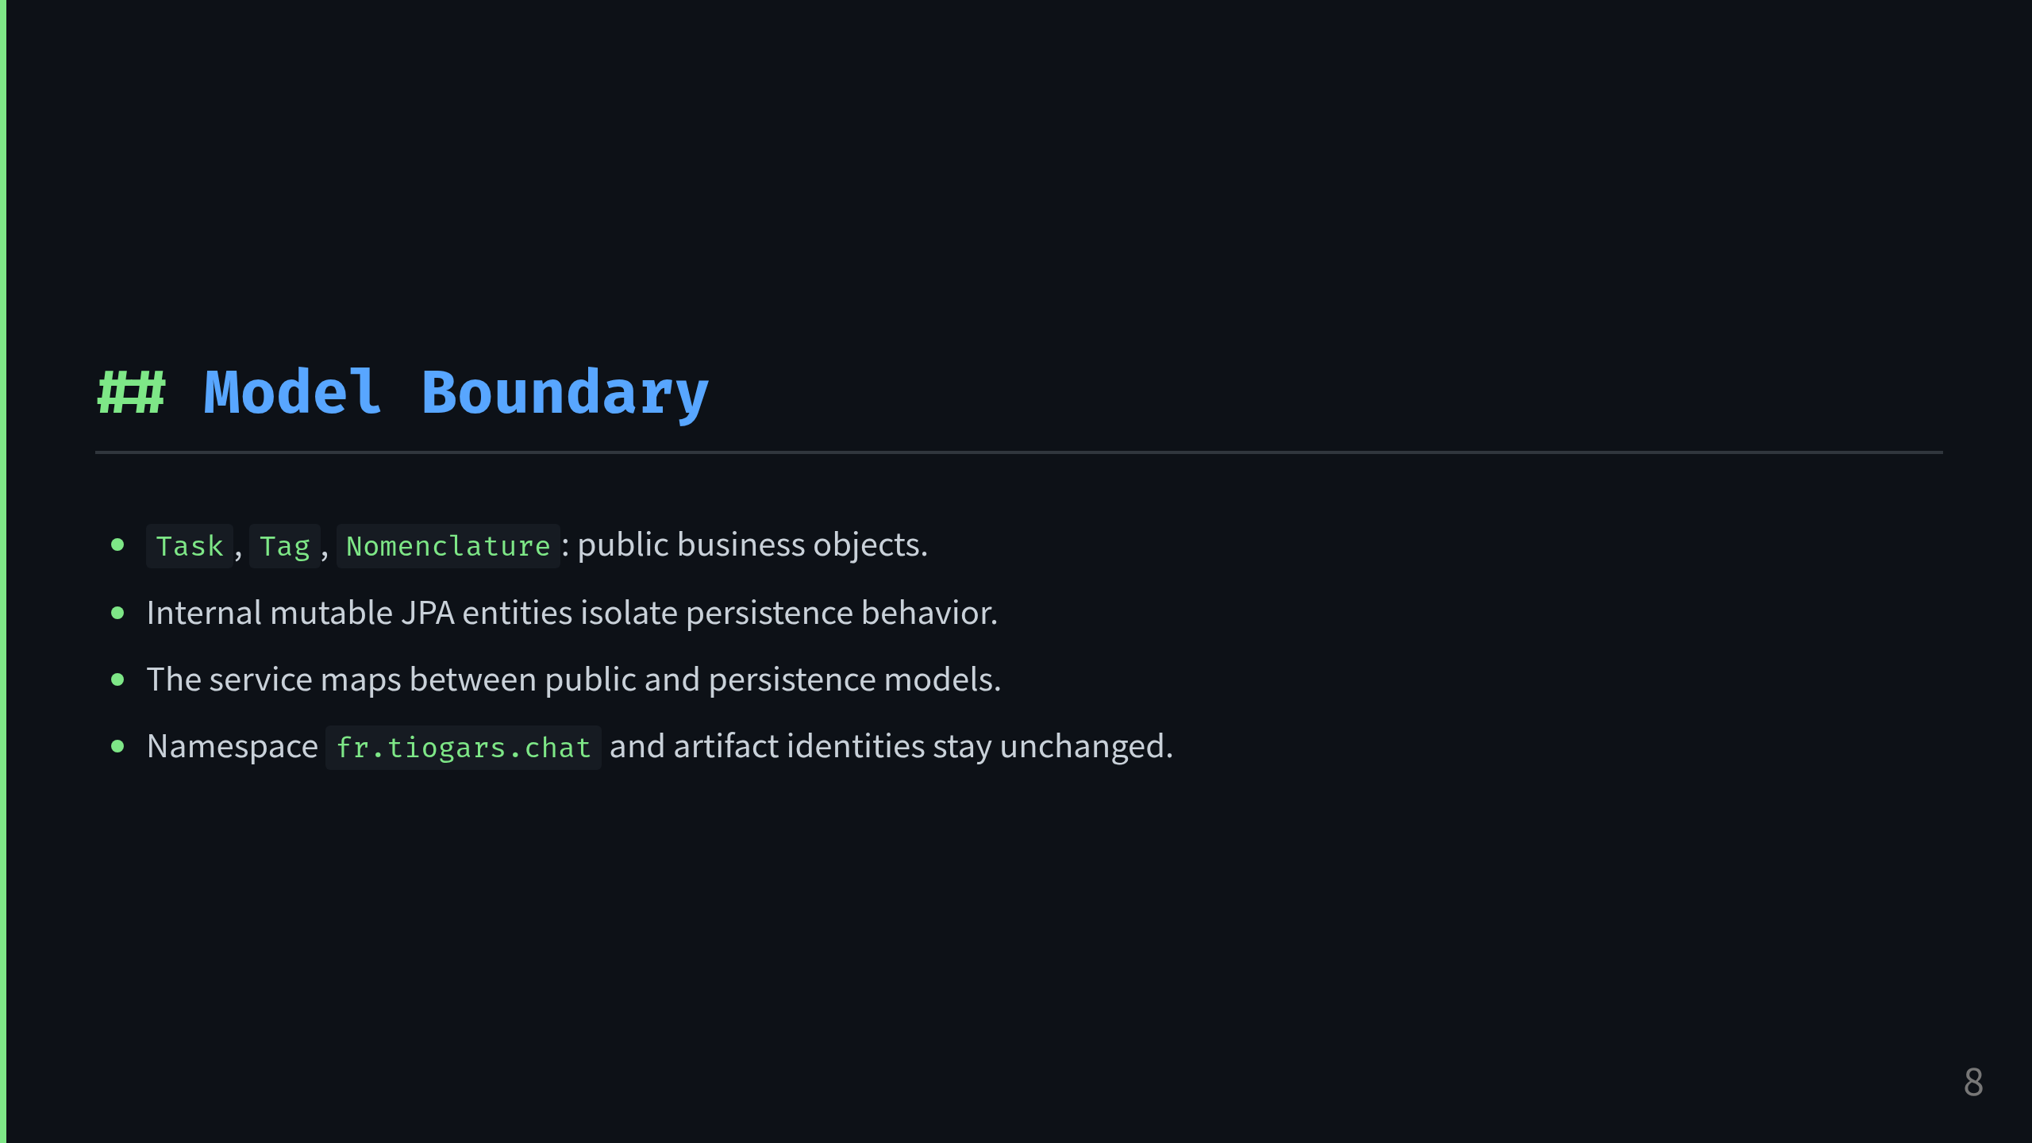
Notes:
Presenter note:
Reinforce the architectural boundary:
public domain model vs persistence model.
This keeps the API honest and prevents leaking JPA details.

Slide 9
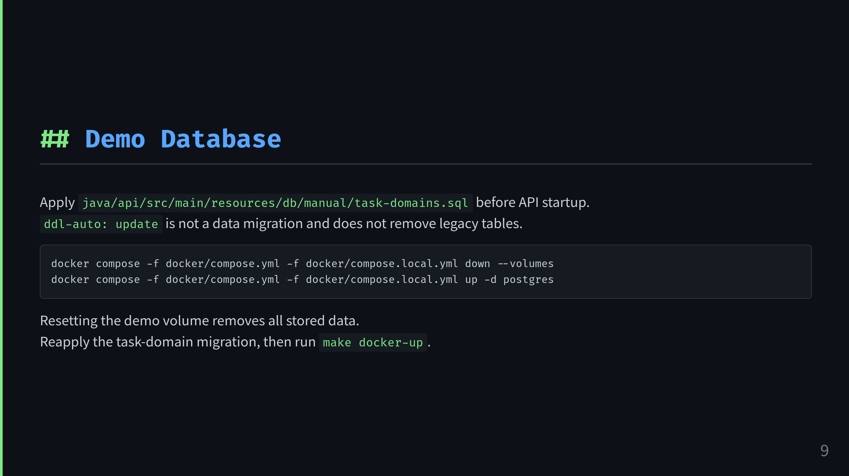
Notes:
Presenter note:
Mention the demo database setup and the known caveat that the old table is not auto-dropped, so a full volume reset is the cleanest way to start fresh.

Slide 10
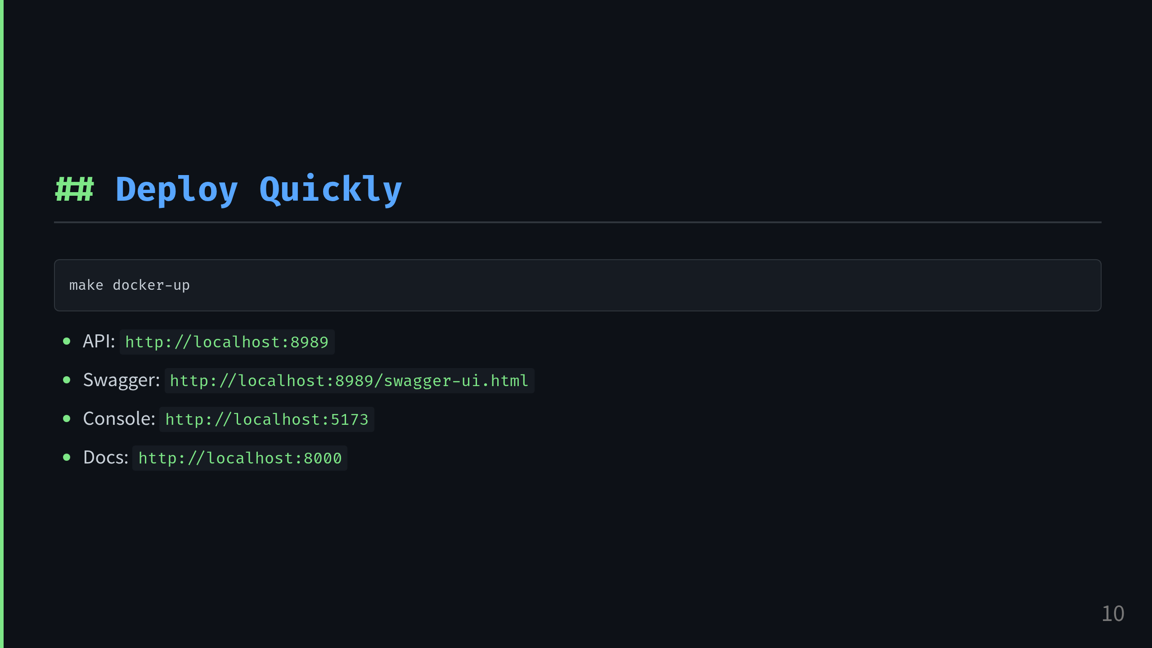
Notes:
Presenter note:
End on the operational path:
start the stack, open API, console, docs, and show that the repo is designed for quick local validation.

Slide 11
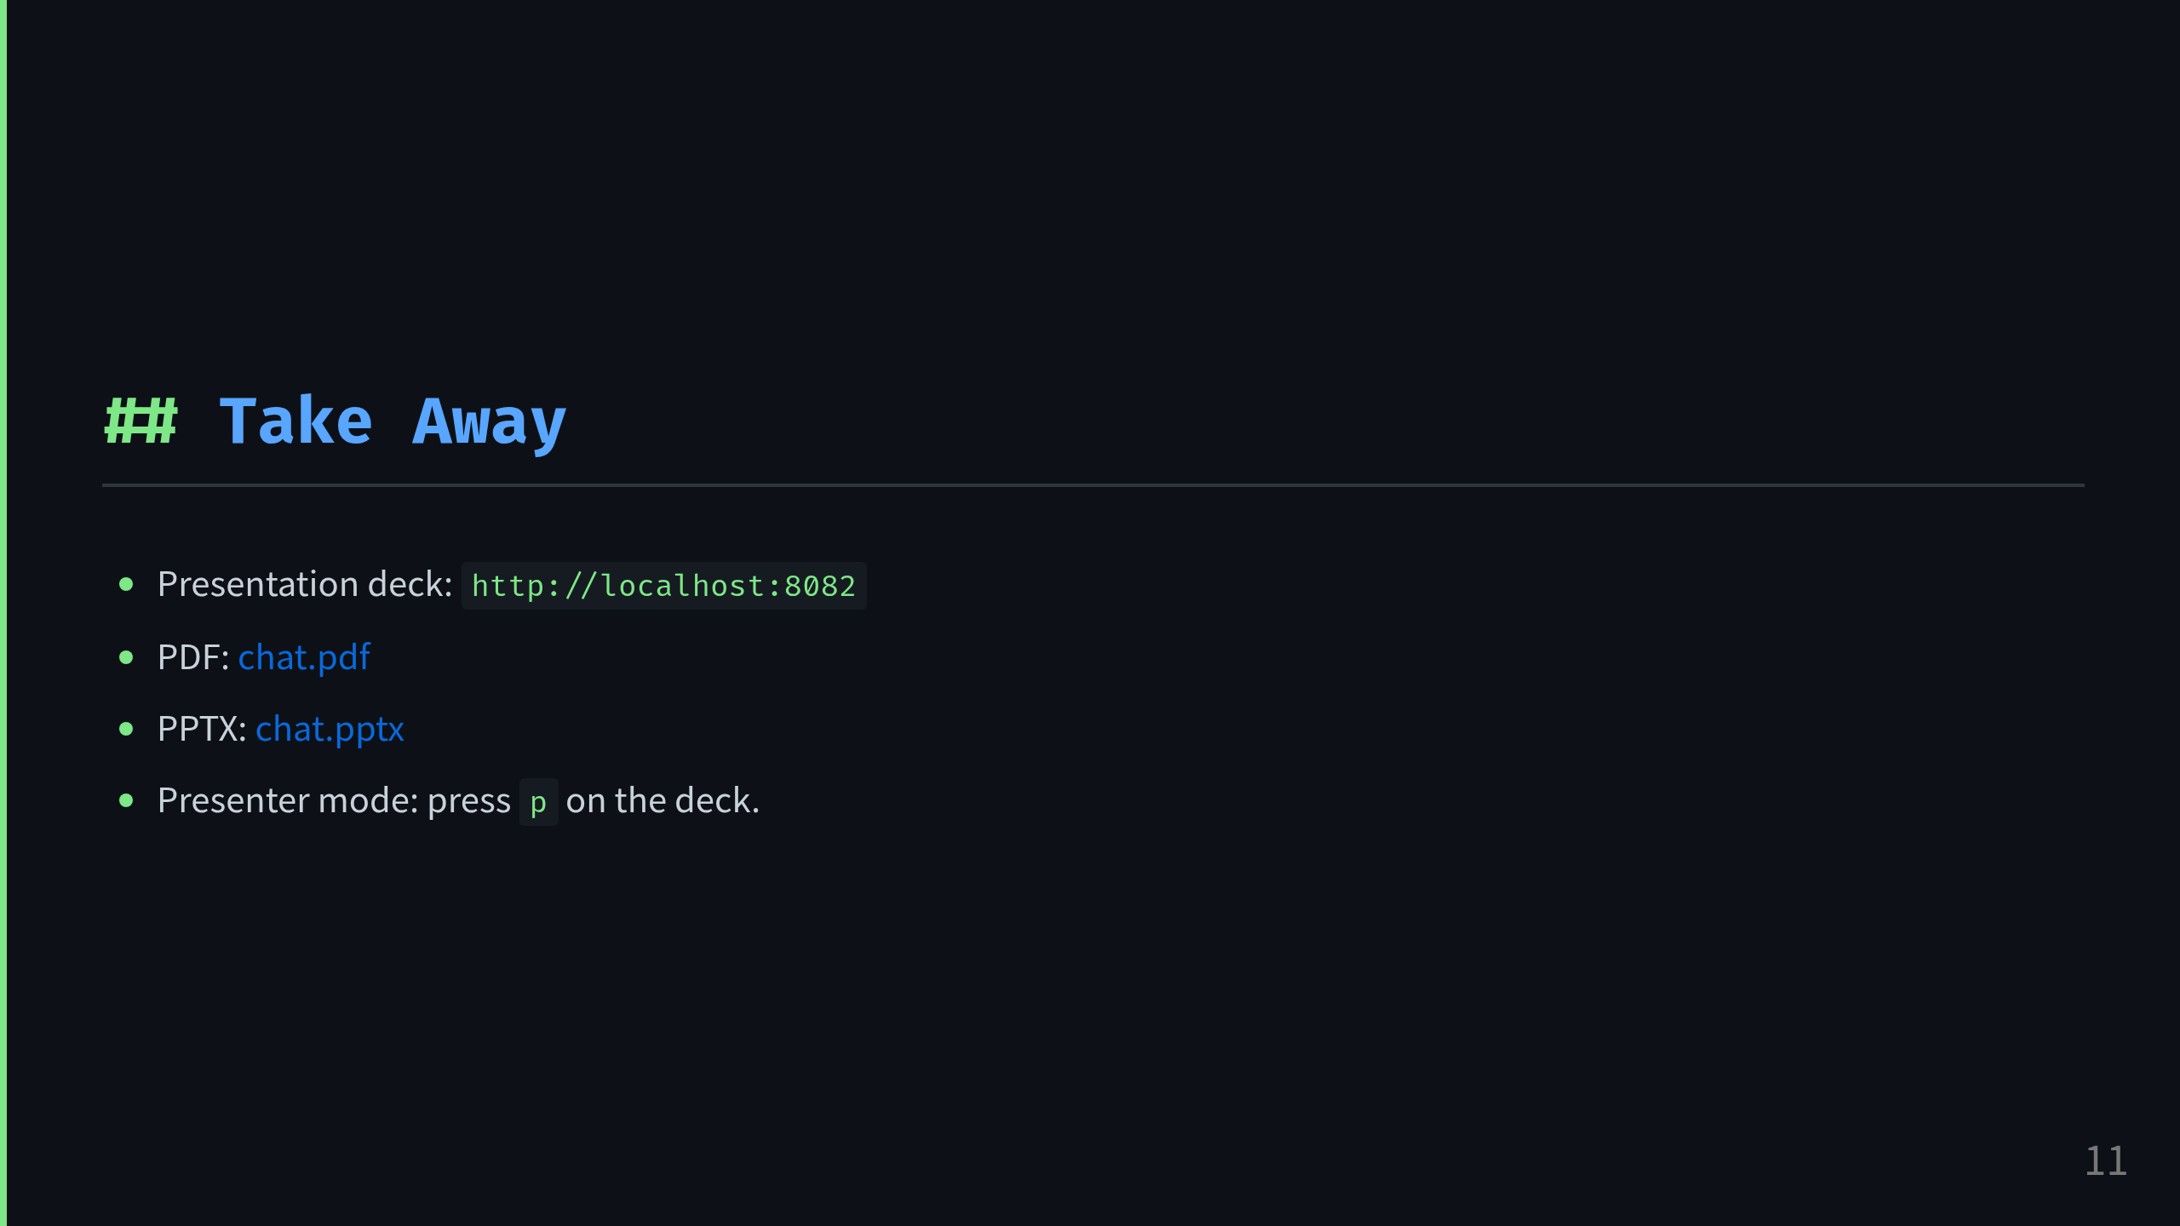
Notes:
Presenter note:
The container serves the interactive Bespoke deck plus the exported PDF and PPTX built at image build time.

